Slide 1
Unit 5
Graph Theory

Slide 2
Graph
Definition:
A simple graph G = (V, E) consists of V, a nonempty set of vertices, and E, a set of unordered pairs of distinct elements of V called edges.
Graph G consists of two things:
1. A set V=V(G) whose elements are called vertices, points or nodes of G.
2. A set E = E(G) of an unordered pair of distinct vertices called edges of G.
3. We denote such a graph by G(V, E).

Slide 3
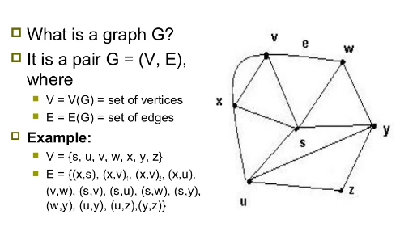
Example

Slide 4
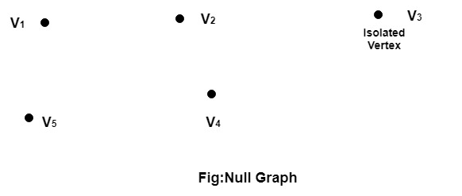
Types of Graphs
Null Graph: A null graph is a graph in which there are no edges between its vertices.
A null graph is also called empty graph.
Example: The graph shown in fig is a null graph, and the vertices are isolated vertices.

Slide 5
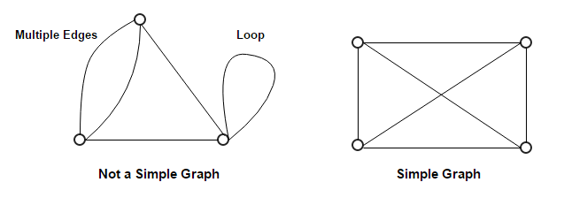
Types of Graphs
2. Simple Graph
A simple graph is the undirected graph with no parallel edges and no loops.

Slide 6
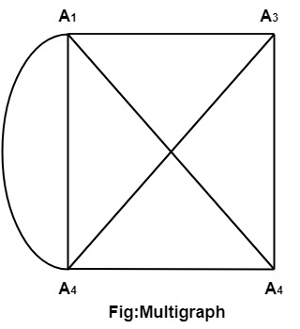
Types of Graphs
3. Multigraph: If in a graph multiple edges between the same set of vertices are allowed, it is known as Multigraph.
In other words, it is a graph having at least one loop or multiple edges.

Slide 7
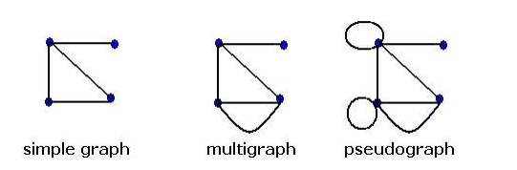
Types of Graphs
4. Pseudograph: A pseudograph is a non-simple graph in which both graph loops and multiple edges are permitted.
In other words, it is a graph having at least one loop.

Slide 8
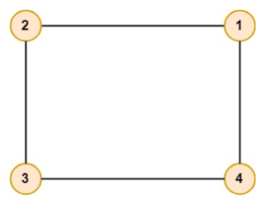
Types of Graphs
5. Undirected Graphs: An Undirected graph G consists of a set of vertices, V and a set of edge E.
An undirected graph is a graph whose edges are not directed.
Example: Let V = {1, 2, 3, 4} and E = {(1, 2), (1, 4), (3, 4), (2, 3)}.Draw the graph.

Slide 9
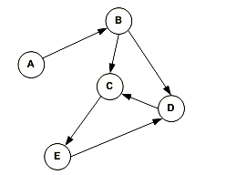
Types of Graphs
5. Directed Graph:
A directed graph is a graph in which the edges are directed by arrows.
Directed graph is also known as digraphs.
In the above graph, each edge is directed by the arrow. A directed edge has an arrow from A to B, means A is related to B, but B is not related to A.

Slide 10
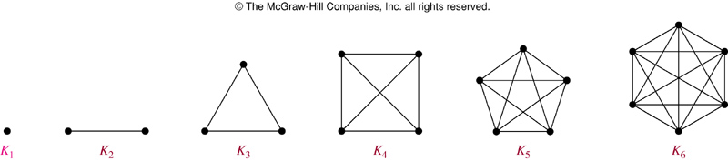
Types of Graphs
6. Complete Graph:
A graph in which every pair of vertices is joined by exactly one edge is called complete graph. It contains all possible edges.
It is represented by Kn.

Slide 11
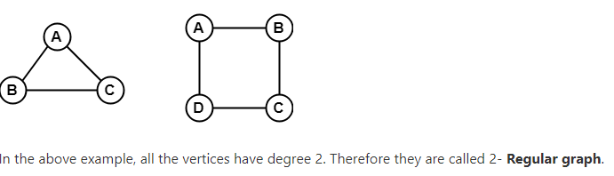
Types of Graphs
7. Regular Graph:
A Regular graph is a graph in which degree of all the vertices is same.
If the degree of all the vertices is k, then it is called k-regular graph.

Slide 12
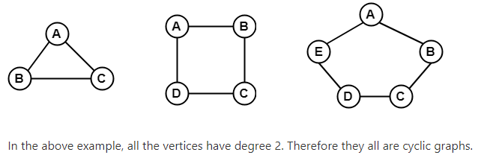
Types of Graphs
8. Cyclic Graph:
A graph with 'n' vertices (where, n>=3) and 'n' edges forming a cycle of 'n' with all its edges is known as cycle graph.
A graph containing at least one cycle in it is known as a cyclic graph.
In the cycle graph, degree of each vertex is 2.
The cycle graph which has n vertices is denoted by Cn.

Slide 13
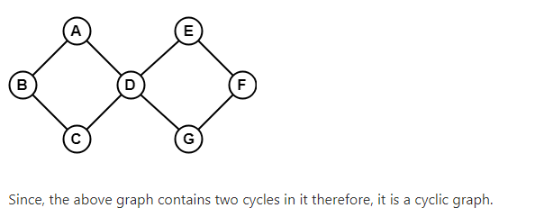

Slide 14
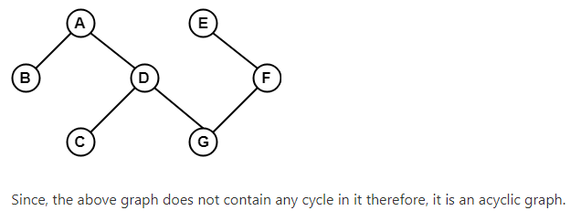
Types of Graphs
9. Acyclic Graph:
A graph which does not contain any cycle in it is called as an acyclic graph.

Slide 15
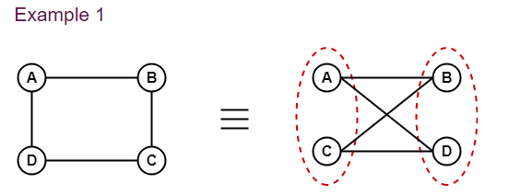
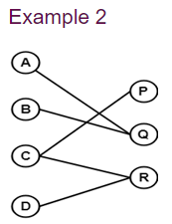
Types of Graphs
10. Bipartite Graph:
A bipartite graph is a graph in which the vertex set can be partitioned into two sets such that edges only go between sets, not within them.

Slide 16
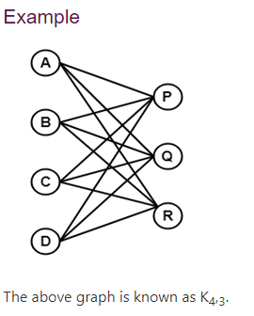
Types of Graphs
11. Complete Bipartite Graph:
A complete bipartite graph is a bipartite graph in which each vertex in the first set is joined to each vertex in the second set by exactly one edge.

Slide 17
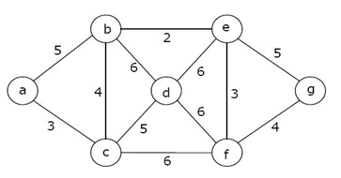
Types of Graphs
12. Weighted Graph:
A weighted graph is a graph whose edges have been labeled with some weights or numbers.

